Slide 1
Algebra I
Keystone Exam
Sample Questions
Problems taken from: Keystone Exams: Algebra I Assessment Anchors and Eligible Content
http://static.pdesas.org/Content/Documents/KYST_ALG1_AAEC_Smpl_Qstns_Glssry_April-2012.pdf

Slide 2
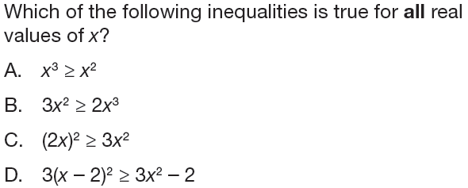
A1.1.1.1.1

Slide 3
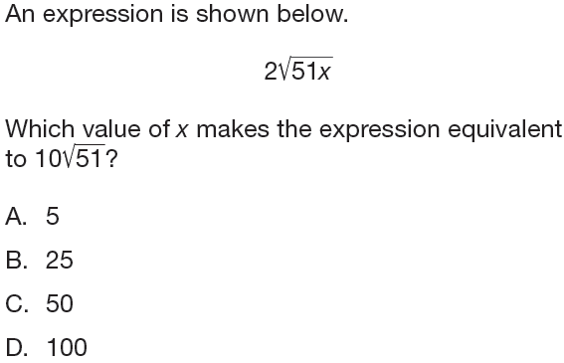
A.1.1.1.1.2

Slide 4
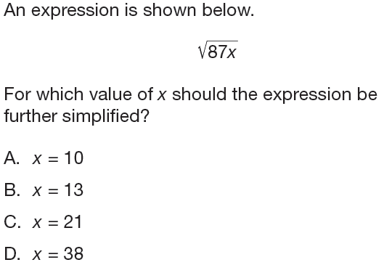
A.1.1.1.1.2

Slide 5
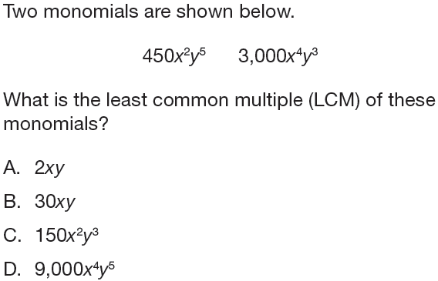
A1.1.1.2.1

Slide 6
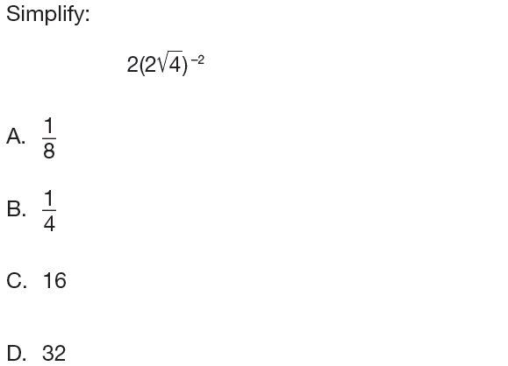
A1.1.1.3.1

Slide 7
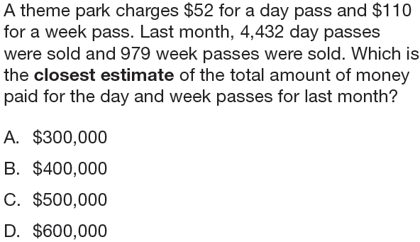
A1.1.1.4.1

Slide 8
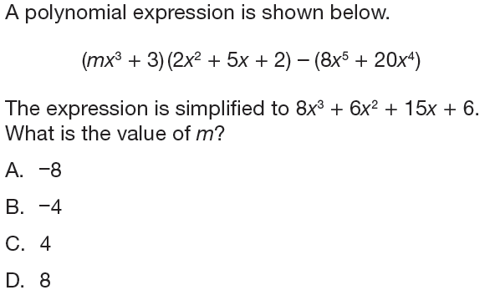
A1.1.1.5.1

Slide 9
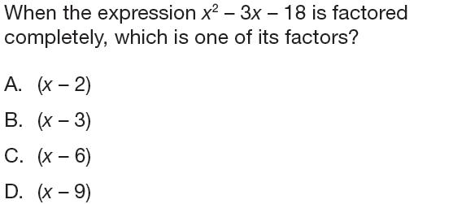
A1.1.1.5.2

Slide 10
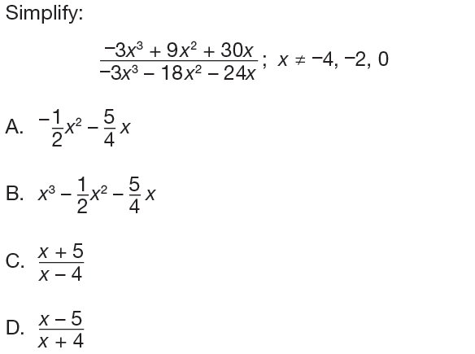
A1.1.1.5.3

Slide 11
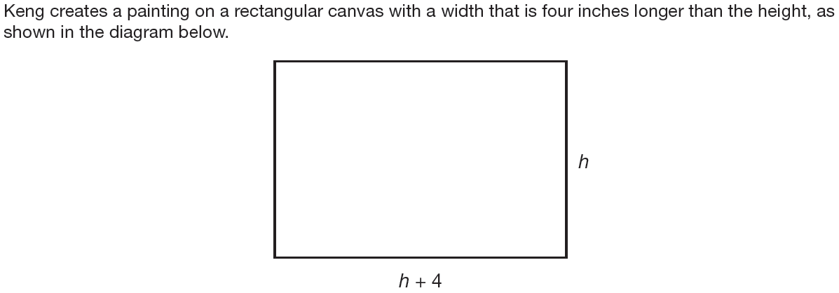
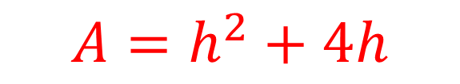
A1.1.1
$$A=h^{2}+4h$$

Slide 12
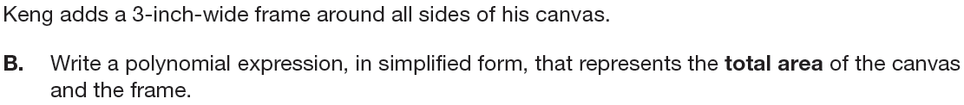
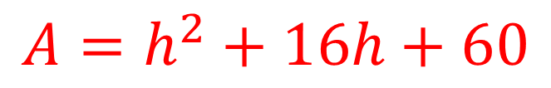
A1.1.1
$$A=h^{2}+16h+60$$

Slide 13
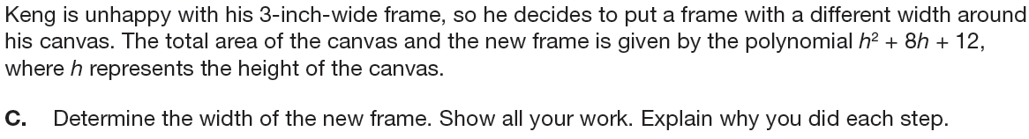
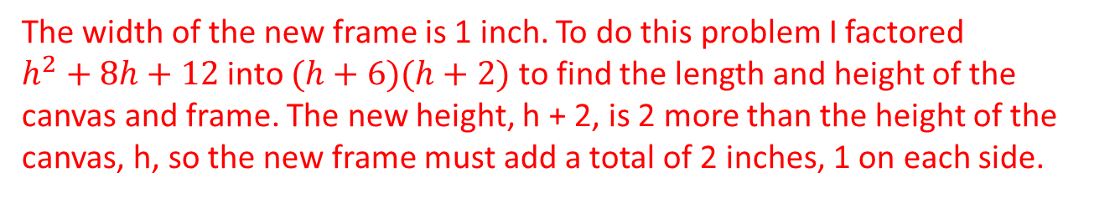
A1.1.1
The width of the new frame is 1 inch. To do this problem I factored $h^{2}+8h+12$ into $(h+6)(h+2)$ to find the length and height of the canvas and frame. The new height, h + 2, is 2 more than the height of the canvas, h, so the new frame must add a total of 2 inches, 1 on each side.

Slide 14
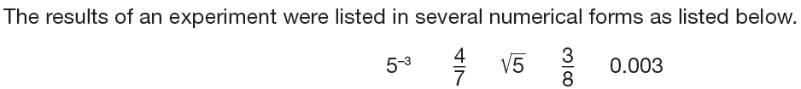

A1.1.1
$$0.003, 5^{−3}, \frac{3}{8}, \frac{4}{7}, \sqrt{5}$$

Slide 15
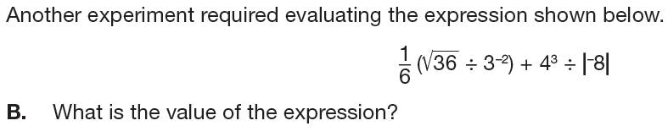

A1.1.1
$$17$$

Slide 16
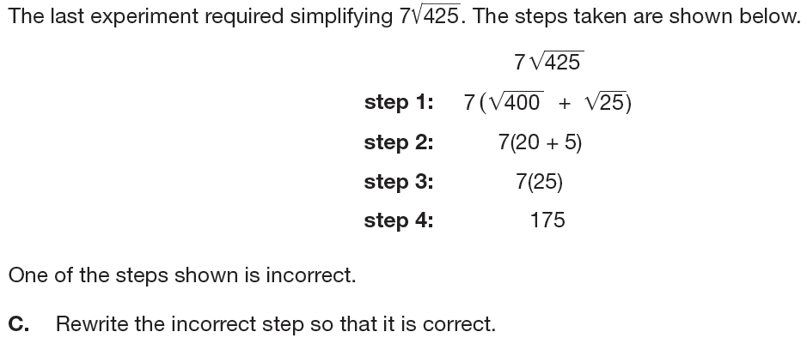
A1.1.1
Step 1 is incorrect. $7\sqrt{425}$should be broken down into the product of its factors, $7\sqrt{25}\sqrt{17 }.$

Slide 17
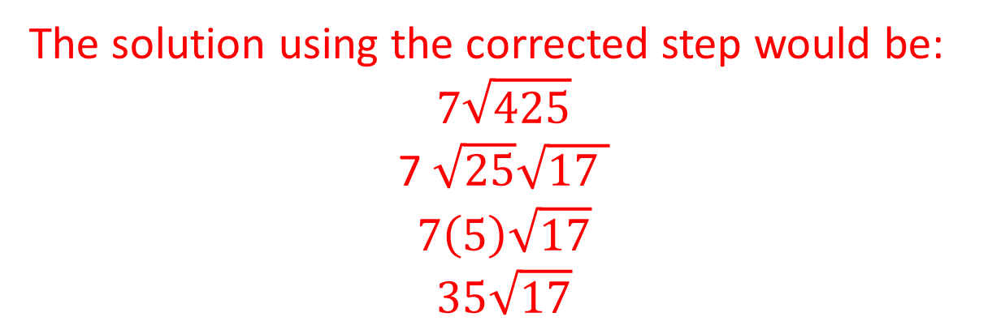
A1.1.1
The solution using the corrected step would be:
$$7\sqrt{425}$$
7 $\sqrt{25}\sqrt{17 }$
$$7\left(5\right)\sqrt{17}$$
$$35\sqrt{17}$$

Slide 18
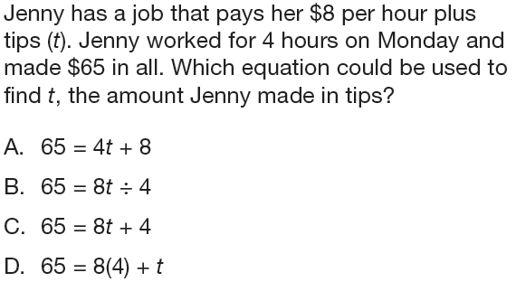
A1.1.2.1.1

Slide 19
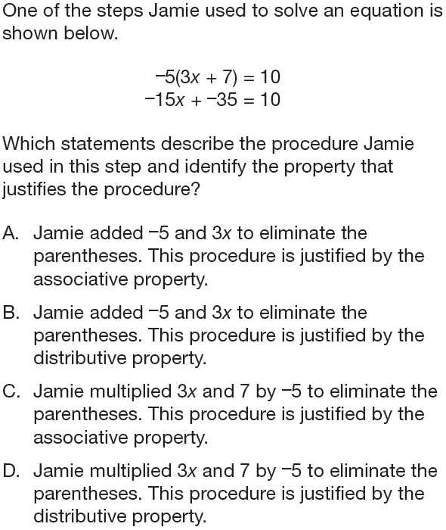
A1.1.2.1.2

Slide 20
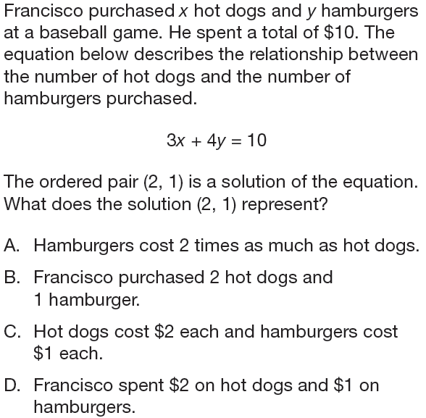
A1.1.2.1.3

Slide 21
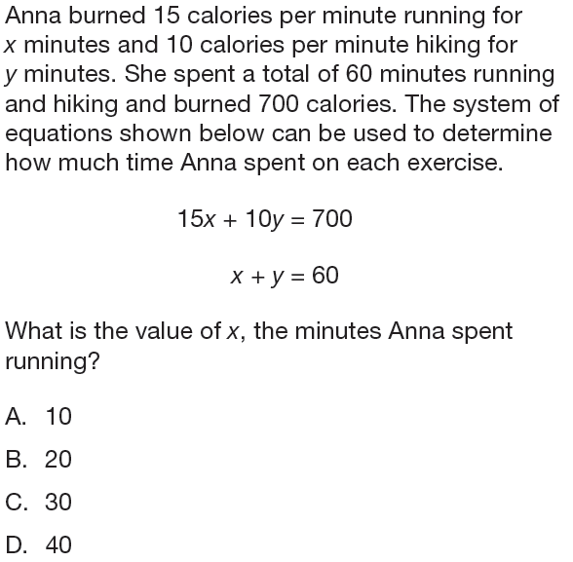
A1.1.2.2.1

Slide 22
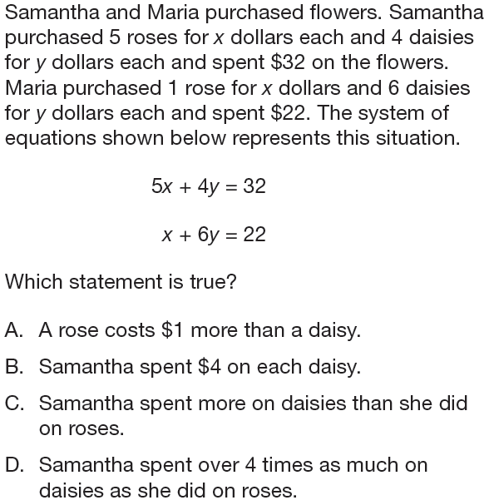
A1.1.2.2.2

Slide 23
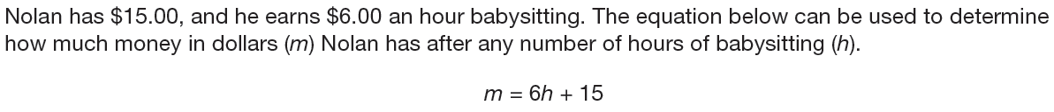
A1.1.2
6 hours

Slide 24
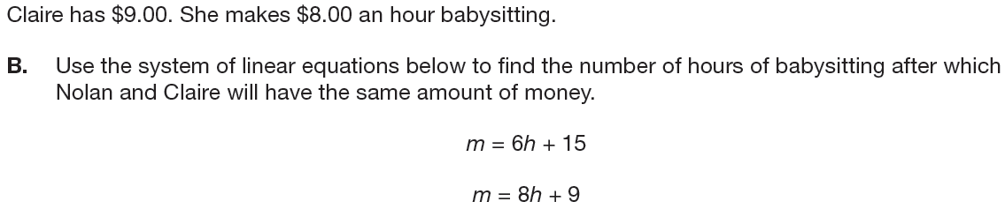
A1.1.2
3 hours

Slide 25
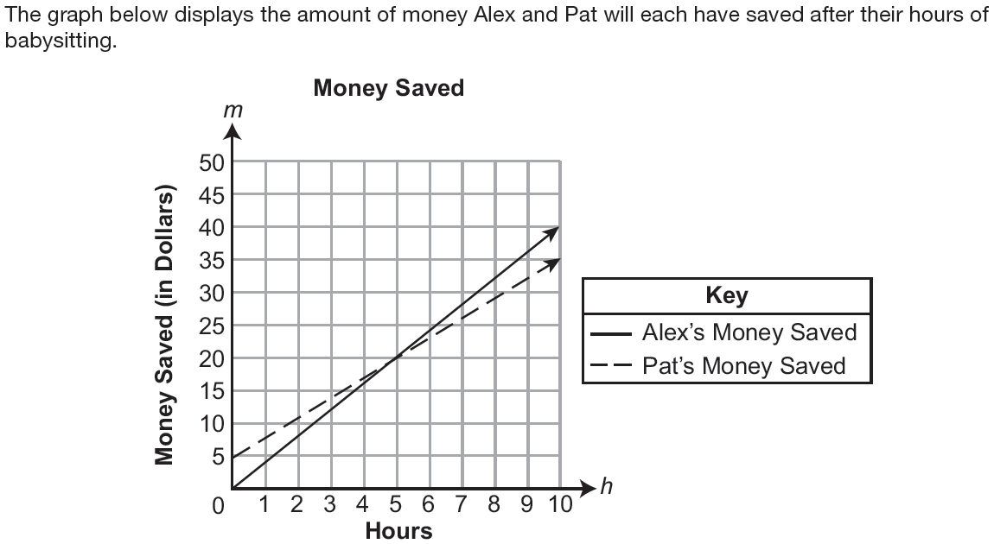
A1.1.2
$h>5$ From 0 hours up to 5 hours, Pat saves more money than Alex. At 5 hours they have saved the same and at all points after 5 hours, Alex will have saved more money.

Slide 26
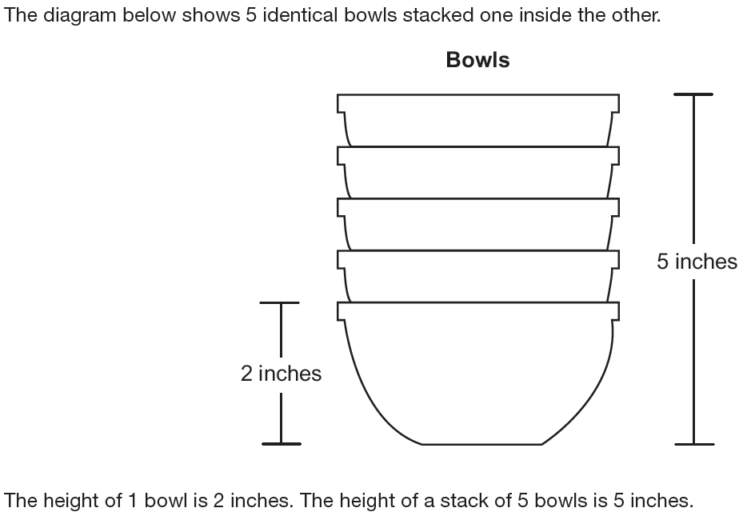
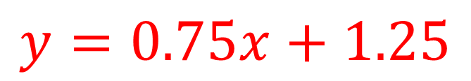
A1.1.2
$$y=0.75x+1.25$$

Slide 27
A1.1.2
x-variable: the number of bowls
y-variable: the height of the stack of bowls

Slide 28
A1.1.2
8.75 inches

Slide 29
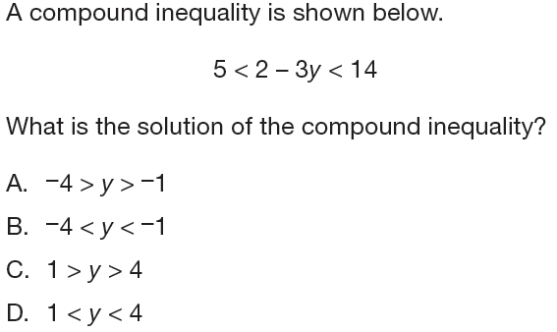
A1.1.3.1.1

Slide 30
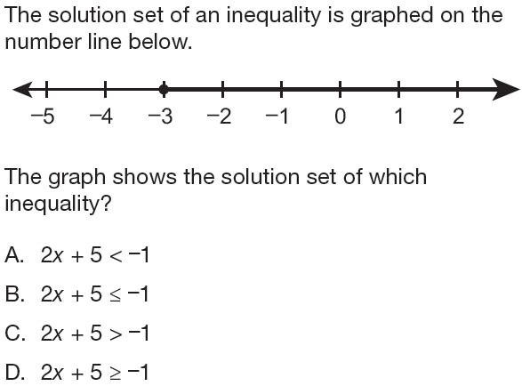
A1.1.3.1.2

Slide 31
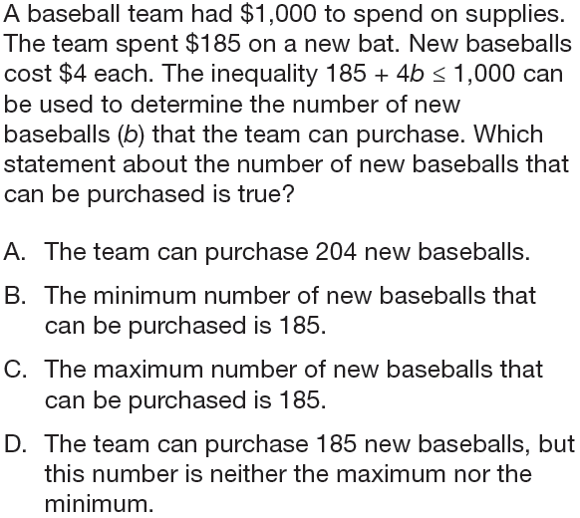
A1.1.3.1.3

Slide 32
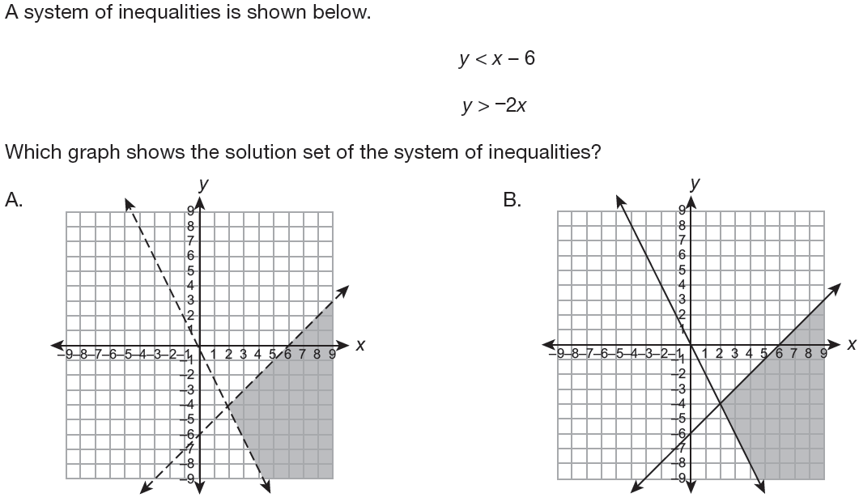
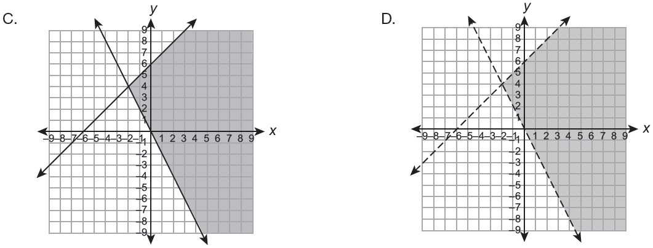
A1.1.3.2.1

Slide 33
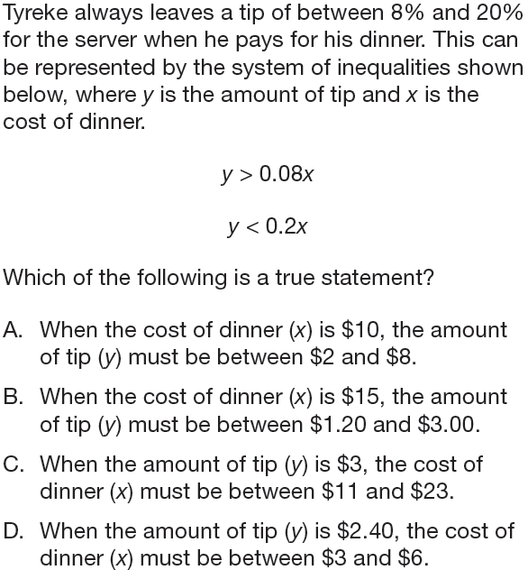
A1.1.3.2.2

Slide 34
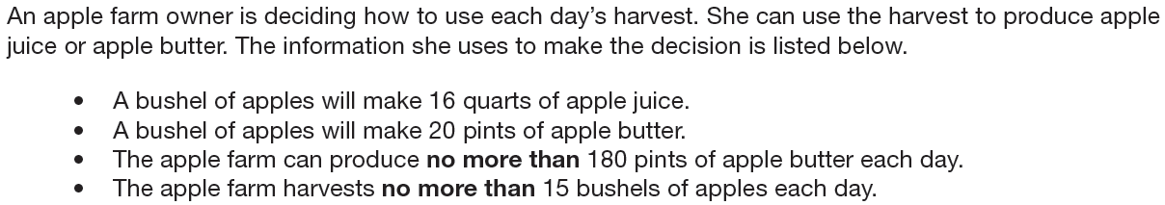
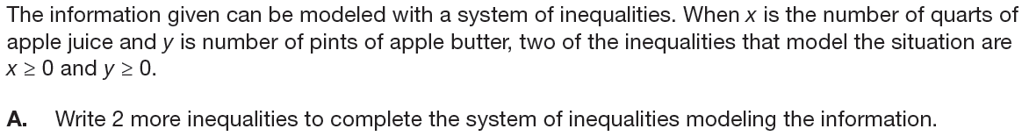
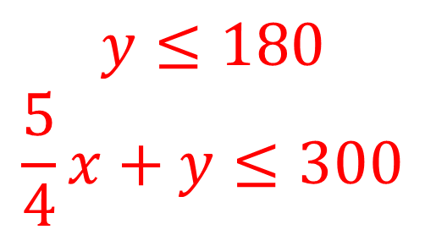
A1.1.3
$$y≤180$$
$$\frac{5}{4}x+y≤300$$

Slide 35
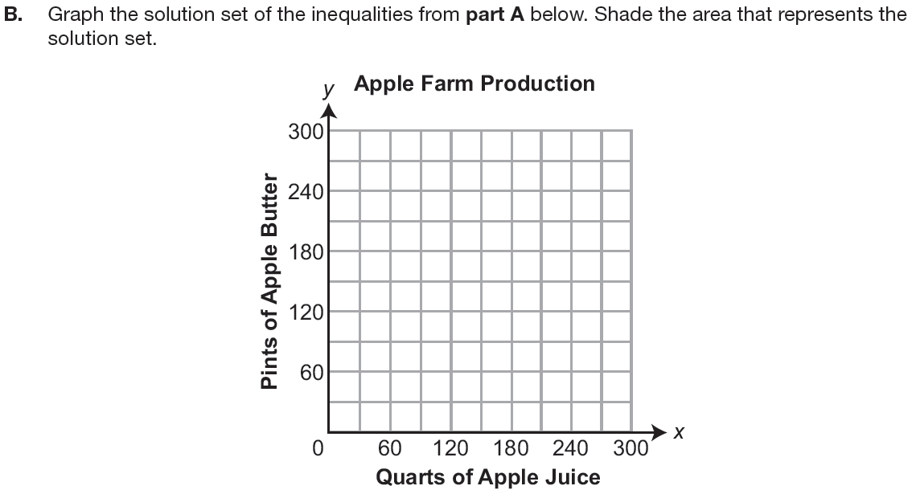
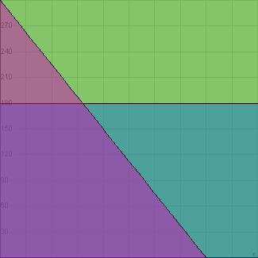
A1.1.3
Dark purple represents solution set

Slide 36
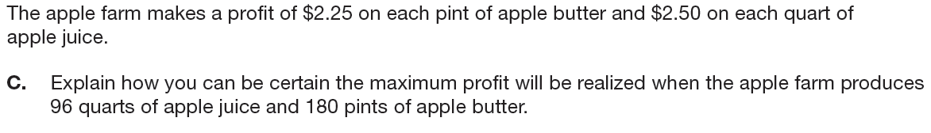
A1.1.3
The maximum profit is represented by the intersection of $y=180$ and $\frac{5}{4}x+y=300$. The point (96, 180) is the intersection of these two equations.

Slide 37
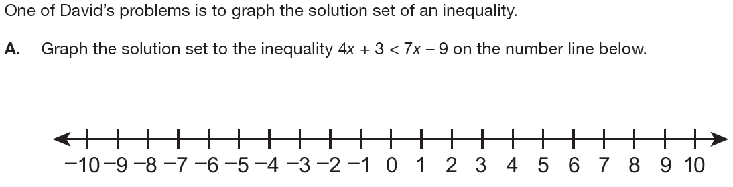
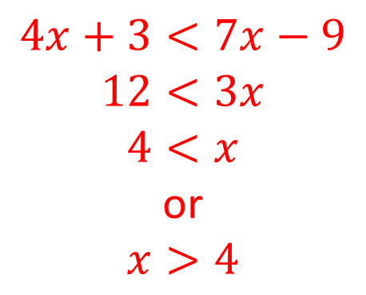
A1.1.3
$$4x+3<7x−9$$
$$12<3x$$
$$4<x$$
or
$$x>4$$

Slide 38
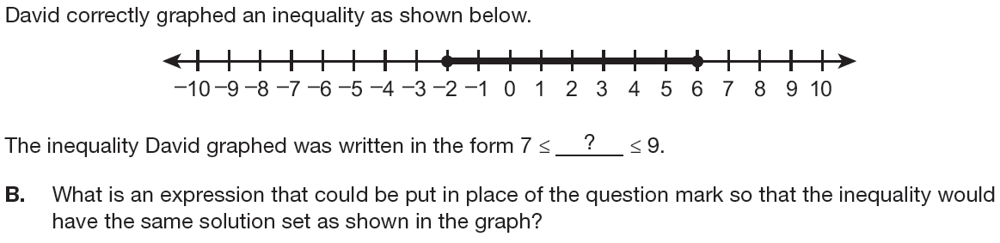
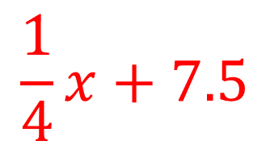
A1.1.3
$$\frac{1}{4}x+7.5$$

Slide 39
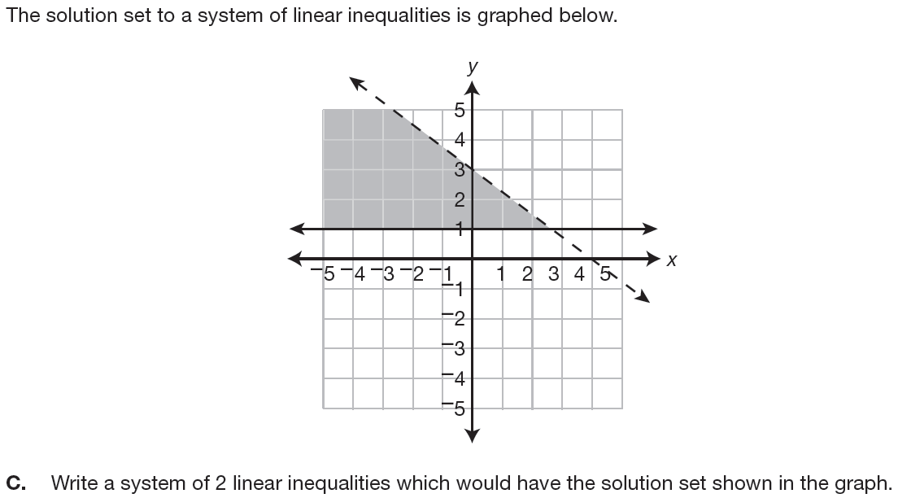
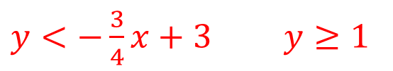
A1.1.3
$y<−\frac{3}{4}x+3$ $y≥1$

Slide 40
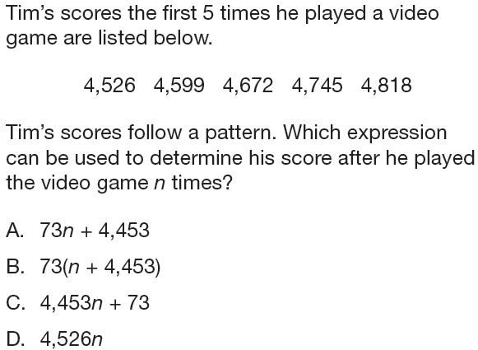
A1.2.1.1.1

Slide 41
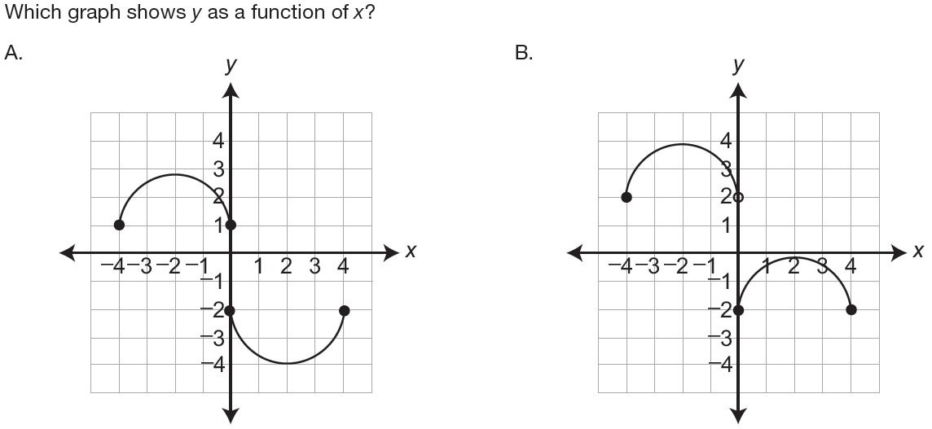
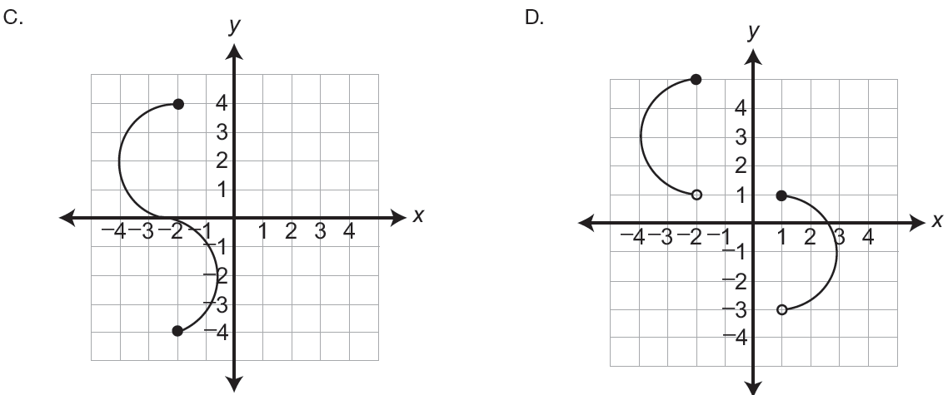
A1.2.1.1.2

Slide 42


A1.2.1.1.3

Slide 43

A1.2.1.2.1

Slide 44

A1.2.1.2.2

Slide 45


A1.2.1
$$d=62h+84$$

Slide 46

A1.2.1
11
6
1

Slide 47

A1.2.1

Slide 48
A1.2.1
As the distance driven (d) increases, the amount of gasoline (g) must decline.

Slide 49


A1.2.1
$$y=24x−220$$

Slide 50

A1.2.1
$$\$220.00$$

Slide 51

A1.2.1
$$10$$

Slide 52
A1.2.1
-220 represents the cost of materials. As the values of the range increase from –220, Ben is losing less money. When the range becomes positive, Ben is making a profit.

Slide 53

A1.2.2.1.1

Slide 54


A1.2.2.1.2

Slide 55


A1.2.2.1.3

Slide 56

A1.2.2.1.4

Slide 57

A1.2.2.2.1

Slide 58

A1.2.2
$$.40x+.25y=10$$

Slide 59

A1.2.2

Slide 60

A1.2.2
$$−\frac{8}{5}$$

Slide 61
A1.2.2
The slope represents the fact that for every 8 granola bars that Georgia purchases, she could by 5 fruit bars.

Slide 62



A1.2.2
$14$ hours

Slide 63


A1.2.2
$560$ mph

Slide 64


A1.2.2
$$y=.00032x$$

Slide 65


A1.2.2
$1166\frac{2}{3}$ miles

Slide 66

A1.2.3.1.1

Slide 67


A1.2.3.2.1

Slide 68

A1.2.3.2.2

Slide 69


A1.2.3.2.3

Slide 70

A1.2.3.3.1

Slide 71


A1.2.3
$$40$$

Slide 72

A1.2.3
$$25\%$$

Slide 73
A1.2.3
Half of the students scored greater than 68. The median marks the point where half of the students scored greater than. In this case, half of the students scored greater than 68, not 75.

Slide 74

A1.2.3

Slide 75


A1.2.3
$$146$$

Slide 76

A1.2.3
$$153$$

Slide 77


A1.2.3
$148$ and $158$

